Slide 1
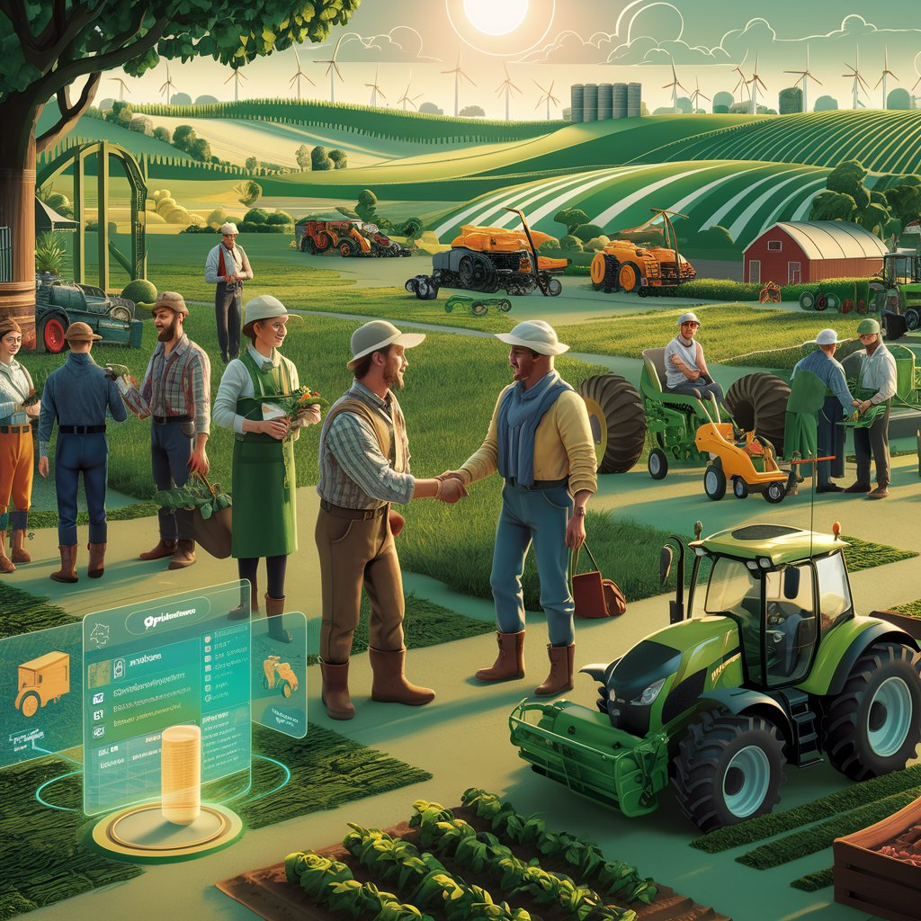
AgriGear Exchange
Farm Equipment Rental Market Place Web Application

Slide 2
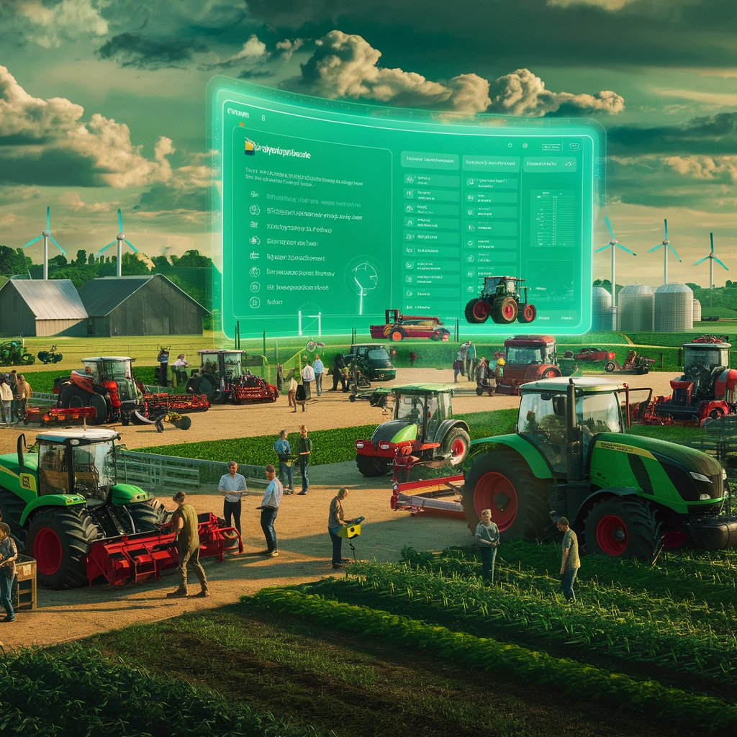
OVERVIEW
Name Of Hackathon:
Problem Statement:
HACKOUT 2024
High Costs and Inaccessibility of Farm Equipment
Team Name:
Code Titans
Team: Vidit Shah
Prakash Suthar
Meet Gandhi
Dhairya Nayak

Slide 3

OUTLINE
Problem Statement
IDEA / Approach Details
Dependencies
UseCase Diagram
System Flow Diagram
Two-Day Workflow for Building a AgriGear Exchange Web App
Two-Day Workflow Diagram
status.

Slide 4
PROBLEM STATEMENT
Small-scale farmers consistently encounter significant barriers due to the prohibitive costs associated with purchasing, maintaining, and upgrading essential agricultural equipment. These high expenses can deplete limited financial resources and prevent these farmers from employing modern farming techniques, thereby reducing their crop yields and operational efficiency.
Furthermore, the physical inaccessibility of such equipment, often due to geographic and logistical constraints, exacerbates the issue, leaving many farmers without the necessary tools to compete effectively or expand their operations. Consequently, there is an urgent need for an innovative solution that facilitates cost-effective access to these vital resources, enabling farmers to maximize productivity, sustain their livelihoods, and contribute more significantly to the agricultural sector.
status.

Slide 5
IDEA / APPROACH DETAILS
The AgriGear Exchange (Farm Equipment Rental Marketplace) is designed to connect farmers with equipment owners, facilitating access to necessary machinery without the cost of purchase. This platform aims to boost agricultural productivity by enabling a sharing economy that reduces operational costs for farmers.
The web application will feature user-friendly interfaces for account creation, equipment listings, and reservation management. Equipment owners can post detailed listings, while farmers can search for and reserve equipment through an intuitive interface.
A robust search and filter system will help users find equipment by location, type, and price. A secure payment gateway will ensure safe financial transactions, providing a seamless experience for both parties.
The platform will offer customer support and dispute resolution services, ensuring a smooth rental process and addressing any issues that may arise.
status.

Slide 6


DEPENDENCIES AND USE CASES
DEPENDENCES
Visual Code IDE | PyCharm
SQLite
Pythonanywhere | render
Python PyPi django-admin-interface
Python PyPi django-bootstrap4
Python PyPi pillow
Python PyPi Gunicorn
Python PyPi numpy
Python PyPi pandas
Python PyPi djangorestframework
1. Python
3. REST API
5. CSS
7. Bootstarp
2. DJango
4. HTML
6. JavaScript
8. Google Firebase/
Python Hosting
TECHNOLOGY STACK

Slide 7
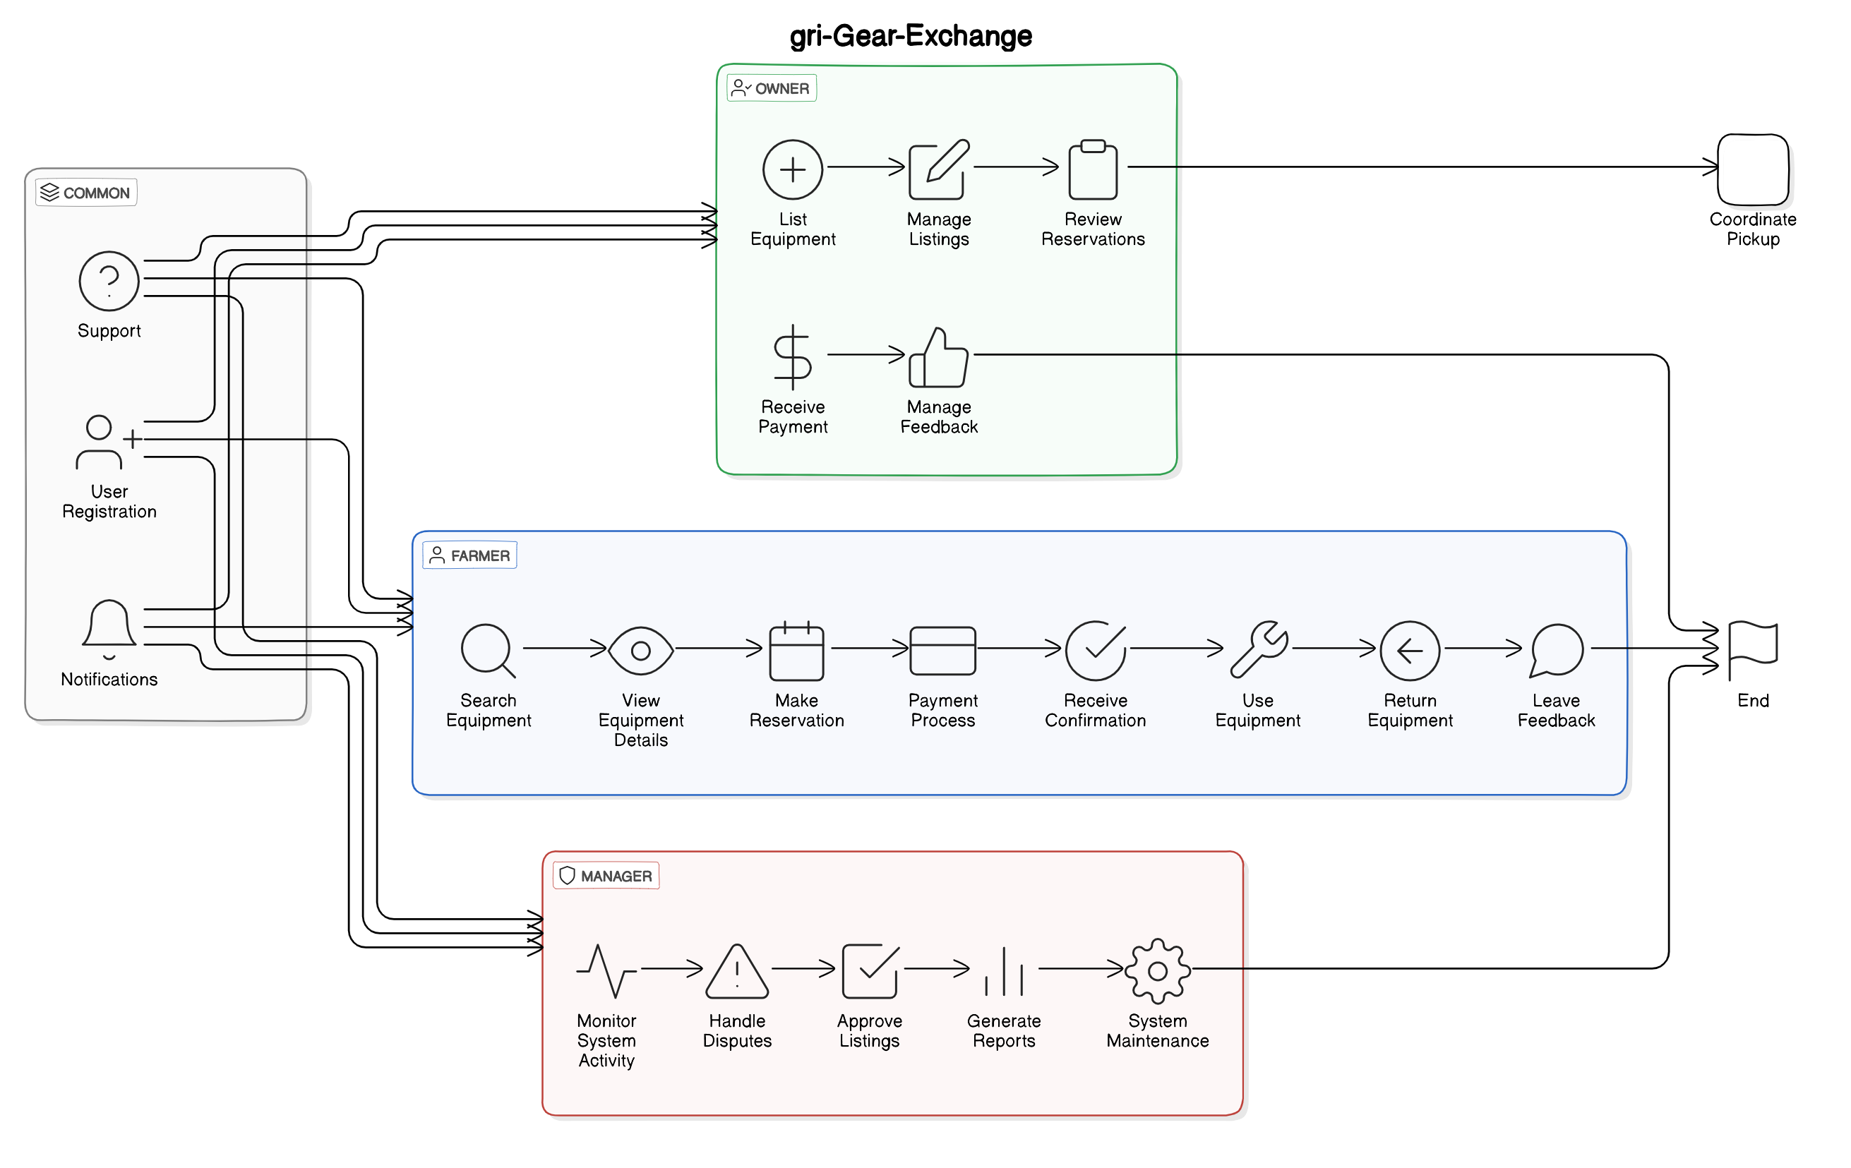
USECASE Diagram:
status.

Slide 8
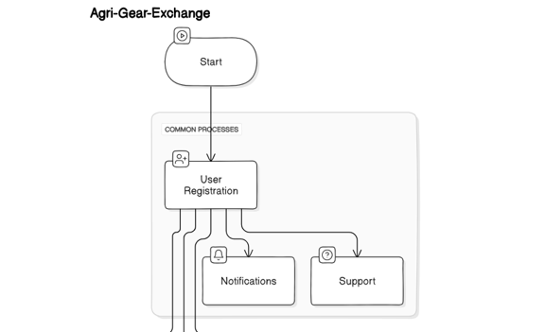
System Flow Diagram:
status.

Slide 9
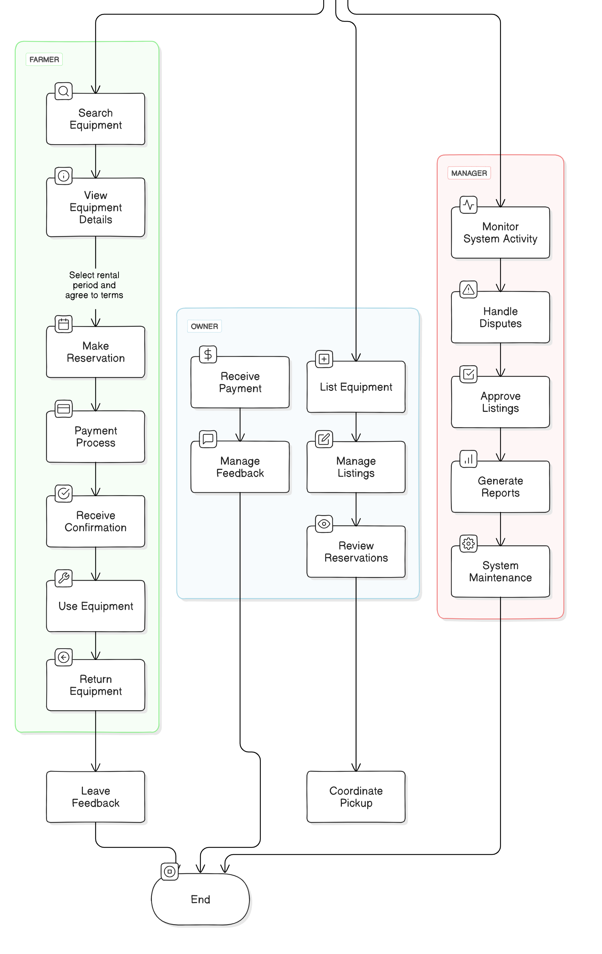
Cont..
status.

Slide 10
Two-Day Workflow for Building a AgriGear Exchange Web App
Day 1: Basic Setup and Core Functionality
Project Setup:
Initialize the Project:
Start a new Django project and set up a basic environment.
Create User Roles:
Set up accounts for three types of users: Farmers, Owners, and Managers.
Database Setup:
Design Models:
Create the database structure to store information about equipment, bookings, payments, and feedback.
Run Migrations:
Apply the database changes to create the necessary tables.
Core Features Development:
Equipment Listing:
Build a system where Farmers can search for and view available equipment.
Booking System:
Allow Farmers to reserve equipment by selecting dates and confirming the rental.
status.

Slide 11
Cont..
4. Basic Frontend:
Create HTML Templates:
Develop simple web pages for the home page, equipment listings, and booking details.
Integrate with Backend:
Connect the web pages with the backend to display real data from the database.
5. Testing Core Features:
Test Basic Workflows:
Ensure Farmers can search for equipment, view details, and make a booking without issues.
status.

Slide 12
Two-Day Workflow for Building a AgriGear Exchange Web App
Day 2: Advanced Features and Polishing
Advanced Backend Features:
Payment Integration:
Set up an online payment system so Farmers can pay for their rentals securely.
Review System:
Allow Farmers to leave reviews and ratings for equipment they’ve rented.
Manager and Admin Features:
Dashboard for Managers:
Build a simple dashboard where Managers can monitor system activity, approve new listings, and handle disputes.
Admin Controls:
Set up the ability for Managers to approve or reject new equipment listings and manage bookings.
Frontend Enhancements:
CSS Styling:
Improve the design with CSS to make the site more attractive and user-friendly.
JavaScript for Interactivity:
Add JavaScript for features like date pickers in the booking process and form validations.
status.

Slide 13
Cont..
4. Final Testing and Deployment:
Comprehensive Testing:
Test all features thoroughly to ensure everything works as expected.
Deploy the System (Optional):
If time allows, deploy the project to a hosting platform like Heroku or AWS for a live demo.
5. Prepare for Presentation:
Finalize the System:
Ensure the project is polished and ready to be shown to others, including any final adjustments needed for the presentation.
status.

Slide 14
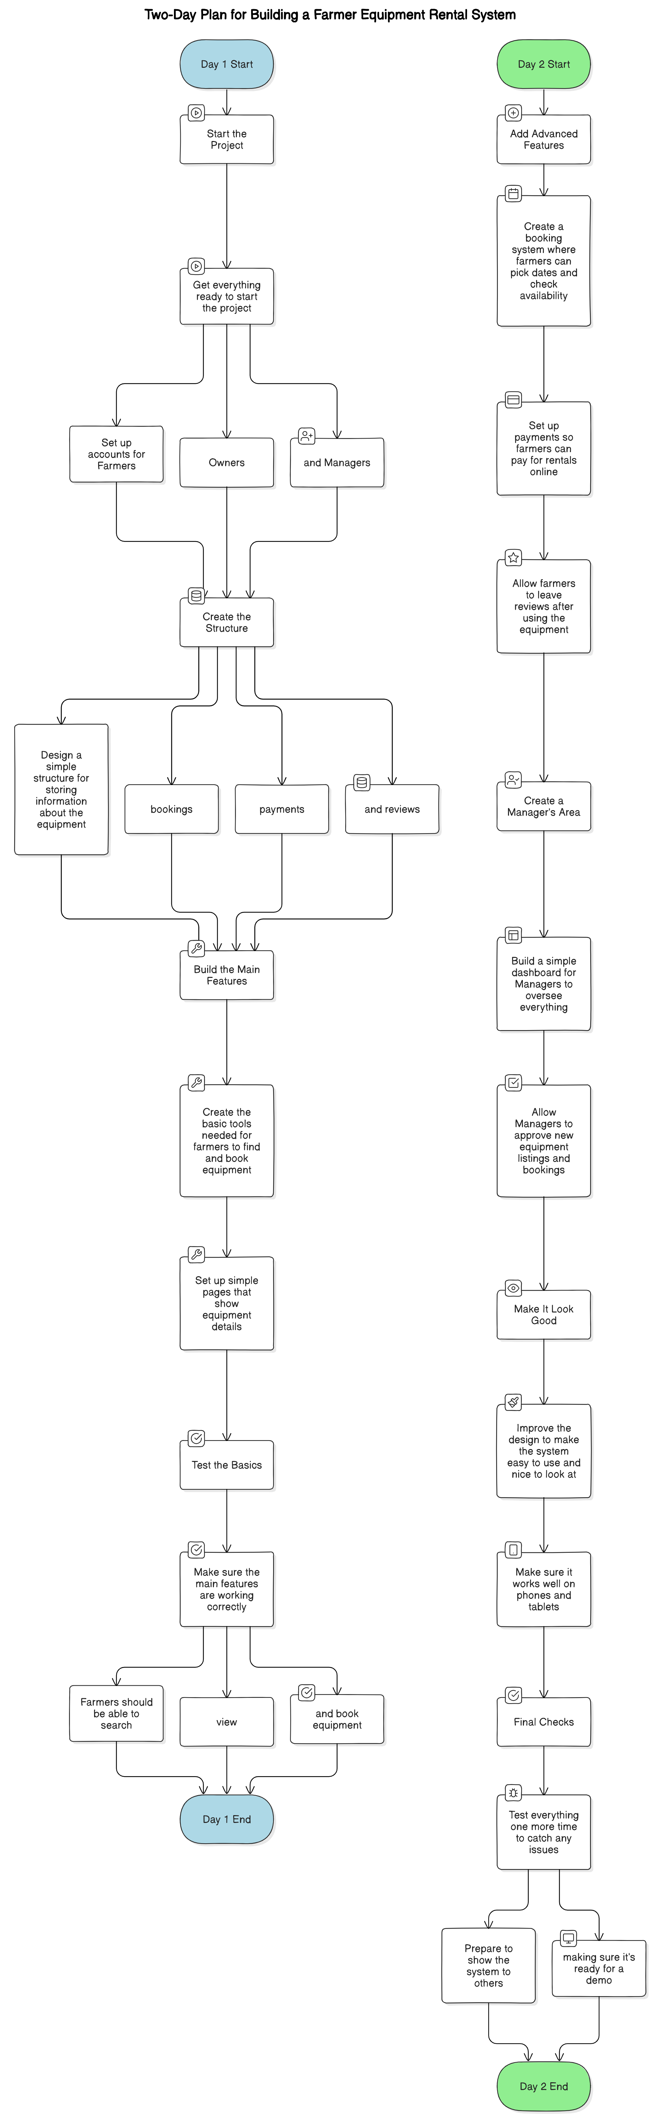
Two Day Workflow Diagram
status.

Slide 15
Cont..
status.

